Slide 1
Sass
CSS Preprocessors | Nesting | Variables and Arithmetic | Control Directives and Expressions
Notes:
Welcome to our lecture on SASS. In this lecture we will go through CSS preprocessors, nesting, variables and artihmetic, and z-index property. Let’s start our lecture.

Slide 2
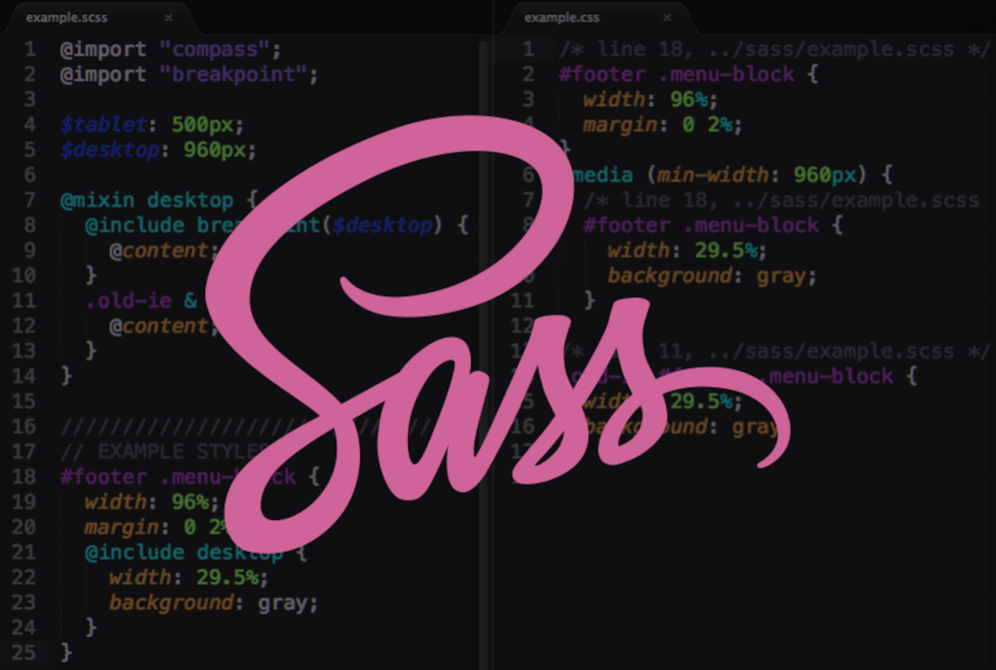
CSS Preprocessor
CSS Preprocessors: Tools like Sass, Less, and Stylus simplify and enhance CSS.
Sass: Compiles .scss to .css, with SCSS (CSS-like) introduced in version 3.
Setup: Install via Sass site or use tools like Koala; older indentation-based syntax still exists.
Notes:
CSS preprocessors like Sass, Less, and Stylus enhance CSS by adding features like variables, nesting, and functions. Sass compiles SCSS files to CSS and introduced SCSS syntax in version 3, which is CSS-like with brackets and semicolons. Sass can be installed via its website or tools like Koala. While SCSS is widely used, the older indentation-based Sass syntax is still supported.

Slide 3
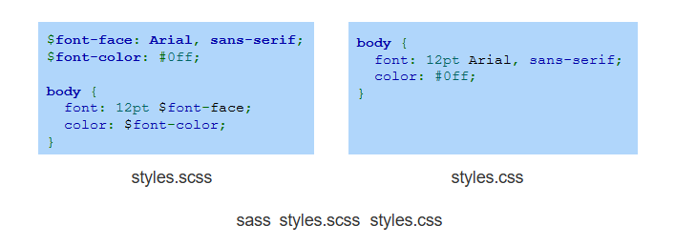
Example
Notes:
This example demonstrates how SCSS uses variables to simplify styling. In the SCSS file, variables like font-face and font-color are defined and reused in the styles. When compiled, SCSS outputs standard CSS with the variable values replaced. This approach improves code readability and maintainability, making it easy to update styles globally by changing variable values.

Slide 4
Nesting
Nesting in Sass: Allows child selectors to be nested within parent selectors for cleaner and more structured code.
Simplified Hierarchies: Nesting organizes styles by visually representing selector relationships, making code easier to read and maintain.
Notes:
Now move on to nesting. Nesting in Sass allows child selectors to be placed within parent selectors, creating cleaner and more structured code. This approach visually represents the relationships between selectors, making styles easier to read and maintain. By simplifying hierarchies, nesting improves organization and reduces repetition, which is especially useful for managing complex stylesheets efficiently.

Slide 5
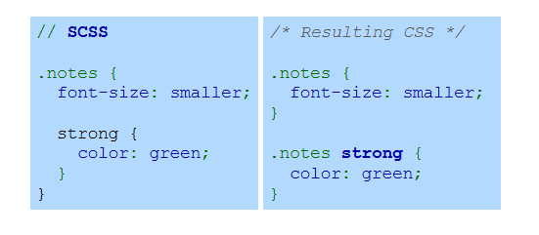
Example
Notes:
This example shows how nesting works in SCSS. The strong selector is nested within the notes selector, indicating a child relationship. When compiled, SCSS generates standard CSS where the strong selector is scoped to the notes parent. This approach simplifies the code structure and ensures styles are applied specifically within the intended context, improving maintainability and clarity.

Slide 6
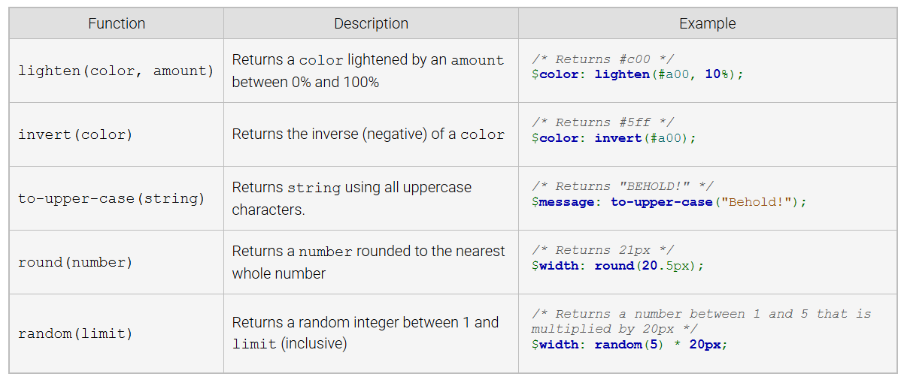
Sass Script Functions
Notes:
Sass Script provides various built-in functions to simplify styling. The lighten function adjusts a color's brightness, invert returns its negative, and to-upper-case converts strings to uppercase. The round function rounds numbers, while random generates random integers. These functions enhance efficiency by adding dynamic behavior and reducing manual calculations in your stylesheets.

Slide 7
Control directives and expressions
Sass contains other features including:
Control directives, like @if and @for, that support conditional styling and looping.
Ability to import SCSS and Sass files using the @import directive.
Ability to extend the styles in a class with the @extend directive.
Ability to write custom functions.
Notes:
Finally, we will look into sass other features. Sass offers powerful features like control directives such as if and for, enabling conditional styling and loops. It supports importing SCSS and Sass files using the import directive, simplifying file management. The extend directive allows styles to be reused across classes, while custom functions enable developers to define reusable logic, making stylesheets more dynamic and maintainable. Thanks for watching the lecture.

